Slide 1

Rationale
Database is an integral part of an organization. Aspiring database developers should be able to efficiently design and implement databases.
Knowledge of these will enable the developers to build robust database solutions.
This module will help students to understand the concepts related to relational databases.

Slide 2
Objectives
In this session, you will learn to:
  Define a database management system
  Describe the types of data models

Slide 3

Database Management Systems
What is a database?

Slide 4

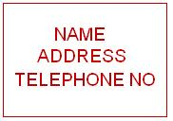

Database Management Systems (Contd.)
A database is a collection of logically related data.
Data means known facts, which are meaningful and can be recorded.
For example:
Address Book
Hard Disk
Notes:
Student already have learnt about type 2 SCDs in Module I. Therefore, you can start this topic by asking the following questions to students:
What are type 2 SCDs?
Given an example to explain type 2 SCDs.
This will recapitulate what they have learnt about type 2 SCD in Module 1.
Now explain the strategy to update the data into these dimension tables with help the example given in SG.
After explaining the examples, you can ask students to think of an example of a type 2 SCD and then tell the strategy to update the data into this dimension table.

Slide 5
Database Management Systems (Contd.)
Database Management Systems (DBMS) is the software required to perform the task of maintaining databases.
Management of data involves:
  Defining structures for data storage.
  Providing methods for data manipulation, such as adding, editing, and deleting data.
  Providing data security against unauthorized access.
Notes:
Student already have learnt about type 2 SCDs in Module I. Therefore, you can start this topic by asking the following questions to students:
What are type 2 SCDs?
Given an example to explain type 2 SCDs.
This will recapitulate what they have learnt about type 2 SCD in Module 1.
Now explain the strategy to update the data into these dimension tables with help the example given in SG.
After explaining the examples, you can ask students to think of an example of a type 2 SCD and then tell the strategy to update the data into this dimension table.

Slide 6
Database Management Systems (Contd.)
The main objectives of any DBMS are to:
  Provide an efficient and easy way to store, update, and retrieve data from a database.
  Manage information about users who interact with the DBMS, and the tasks that these users can perform on the data.
Notes:
You can summarize the session by running through the summary given in SG.
In addition, you can also ask students summarize what they have learnt in this session.

Slide 7

Database Management Systems (Contd.)
Now, let us understand the
working of DBMS.

Slide 8

Database Management Systems (Contd.)
User system to extract information from the database
Request for data
Retrieved data
returned as a result
DBMS
Database
Notes:
You can summarize the session by running through the summary given in SG.
In addition, you can also ask students summarize what they have learnt in this session.

Slide 9
Data Models
What is a data model?

Slide 10
Data Models (Contd.)
A data model is a description of the data in a database.
Data models can be broadly classified into the following categories:
  Object-based logical model:
    Focuses on describing the data, the relationship among the data, and any constraints defined.
  Record-based logical model:
    Focuses on specifying the logical structuring of the database.
Notes:
Student already have learnt about type 2 SCDs in Module I. Therefore, you can start this topic by asking the following questions to students:
What are type 2 SCDs?
Given an example to explain type 2 SCDs.
This will recapitulate what they have learnt about type 2 SCD in Module 1.
Now explain the strategy to update the data into these dimension tables with help the example given in SG.
After explaining the examples, you can ask students to think of an example of a type 2 SCD and then tell the strategy to update the data into this dimension table.

Slide 11
Object-Based Logical Model
Let us understand the
object-based logical model.

Slide 12
Object-Based Logical Model (Contd.)
The ER model:
  Views the real world as a collection of objects or entities and the relationship among them.
  Has a corresponding diagramming technique.
Notes:
Student already have learnt about type 2 SCDs in Module I. Therefore, you can start this topic by asking the following questions to students:
What are type 2 SCDs?
Given an example to explain type 2 SCDs.
This will recapitulate what they have learnt about type 2 SCD in Module 1.
Now explain the strategy to update the data into these dimension tables with help the example given in SG.
After explaining the examples, you can ask students to think of an example of a type 2 SCD and then tell the strategy to update the data into this dimension table.

Slide 13
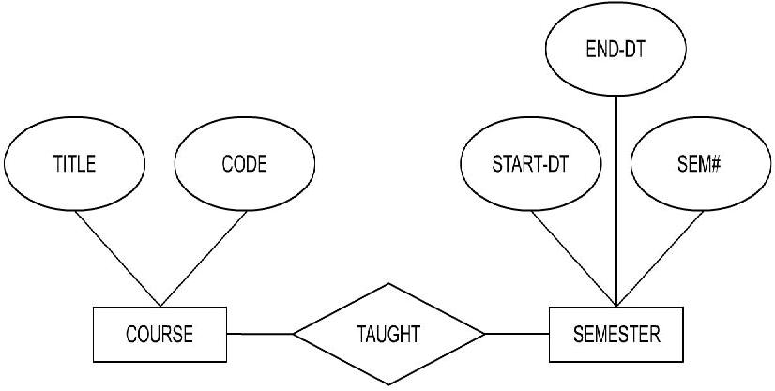
Object-Based Logical Model (Contd.)
The following diagram shows various components and depicts the relationship between them.
Attributes
Attributes
Relationship
Entities
Notes:
Student already have learnt about type 2 SCDs in Module I. Therefore, you can start this topic by asking the following questions to students:
What are type 2 SCDs?
Given an example to explain type 2 SCDs.
This will recapitulate what they have learnt about type 2 SCD in Module 1.
Now explain the strategy to update the data into these dimension tables with help the example given in SG.
After explaining the examples, you can ask students to think of an example of a type 2 SCD and then tell the strategy to update the data into this dimension table.

Slide 14
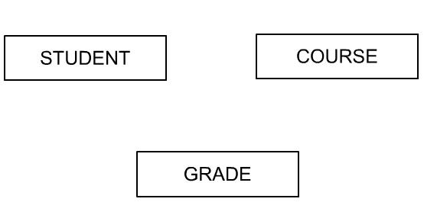
Object-Based Logical Model (Contd.)
An entity:
  Is any object, place, person, or activity about which the data is recorded.
  Can be categorized as entity type and entity instance.
In the ER model diagramming technique, entities are named and represented inside a box.
For example:
Notes:
Student already have learnt about type 2 SCDs in Module I. Therefore, you can start this topic by asking the following questions to students:
What are type 2 SCDs?
Given an example to explain type 2 SCDs.
This will recapitulate what they have learnt about type 2 SCD in Module 1.
Now explain the strategy to update the data into these dimension tables with help the example given in SG.
After explaining the examples, you can ask students to think of an example of a type 2 SCD and then tell the strategy to update the data into this dimension table.

Slide 15
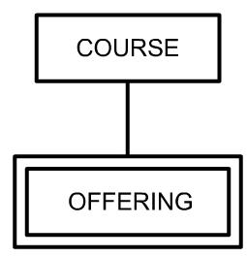
Object-Based Logical Model (Contd.)
Entity can be of the following types:
  Dependent entity:
    Depends on another entity for existence.
    Is also called as a weak entity.
  Independent entity:
    Does not depend on any other entity for existence.
    Is also called as a regular entity.
The following diagram consists of an entity, OFFERING, which is dependent on an entity, COURSE.
Independent Entity
Dependent Entity
Notes:
Student already have learnt about type 2 SCDs in Module I. Therefore, you can start this topic by asking the following questions to students:
What are type 2 SCDs?
Given an example to explain type 2 SCDs.
This will recapitulate what they have learnt about type 2 SCD in Module 1.
Now explain the strategy to update the data into these dimension tables with help the example given in SG.
After explaining the examples, you can ask students to think of an example of a type 2 SCD and then tell the strategy to update the data into this dimension table.

Slide 16
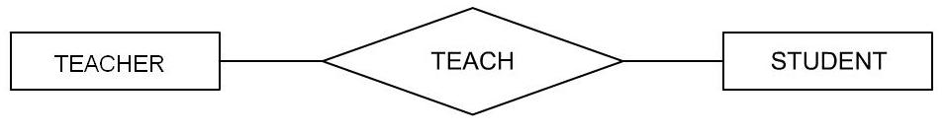
Object-Based Logical Model (Contd.)
Chen defined a relationship as “an association among entities”.
A relationship is depicted as a diamond with the name of the relationship type.
For example:
Relationship
Notes:
Student already have learnt about type 2 SCDs in Module I. Therefore, you can start this topic by asking the following questions to students:
What are type 2 SCDs?
Given an example to explain type 2 SCDs.
This will recapitulate what they have learnt about type 2 SCD in Module 1.
Now explain the strategy to update the data into these dimension tables with help the example given in SG.
After explaining the examples, you can ask students to think of an example of a type 2 SCD and then tell the strategy to update the data into this dimension table.

Slide 17
Object-Based Logical Model (Contd.)
The following diagram represents the association of an entity with itself.
STUDENT
SEMINAR
An entity associating with itself can be a student giving a seminar presentation to other students.
Notes:
Student already have learnt about type 2 SCDs in Module I. Therefore, you can start this topic by asking the following questions to students:
What are type 2 SCDs?
Given an example to explain type 2 SCDs.
This will recapitulate what they have learnt about type 2 SCD in Module 1.
Now explain the strategy to update the data into these dimension tables with help the example given in SG.
After explaining the examples, you can ask students to think of an example of a type 2 SCD and then tell the strategy to update the data into this dimension table.

Slide 18
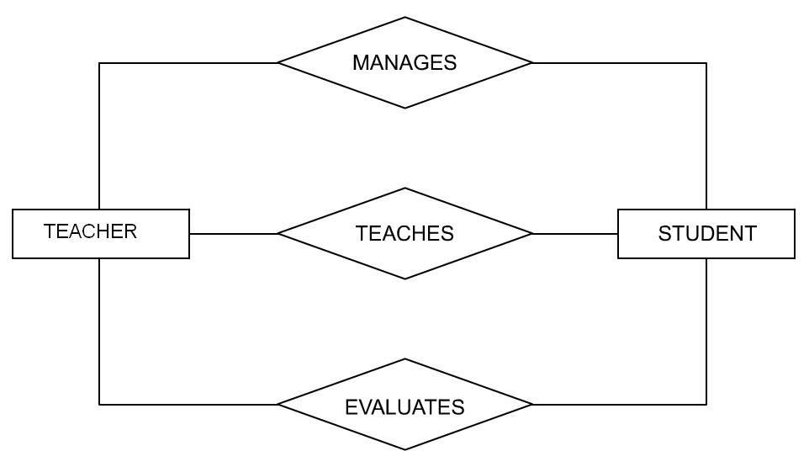
Object-Based Logical Model (Contd.)
The following diagram represents multiple relationships between the entities, TEACHER and STUDENT.
Notes:
Student already have learnt about type 2 SCDs in Module I. Therefore, you can start this topic by asking the following questions to students:
What are type 2 SCDs?
Given an example to explain type 2 SCDs.
This will recapitulate what they have learnt about type 2 SCD in Module 1.
Now explain the strategy to update the data into these dimension tables with help the example given in SG.
After explaining the examples, you can ask students to think of an example of a type 2 SCD and then tell the strategy to update the data into this dimension table.

Slide 19

Just a minute
The following statement has been extracted from a case presented by a manufacturer regarding the maintenance of their data: “A supplier ships certain parts”. Identify the entities mentioned in this statement, and their relationship. Draw a diagram depicting the relationship.
Solution:
  Entities: SUPPLIER, PARTS
  Relationship: SHIP or SUPPLIES
Notes:
Student already have learnt about type 2 SCDs in Module I. Therefore, you can start this topic by asking the following questions to students:
What are type 2 SCDs?
Given an example to explain type 2 SCDs.
This will recapitulate what they have learnt about type 2 SCD in Module 1.
Now explain the strategy to update the data into these dimension tables with help the example given in SG.
After explaining the examples, you can ask students to think of an example of a type 2 SCD and then tell the strategy to update the data into this dimension table.

Slide 20
Object-Based Logical Model (Contd.)
There are three types of relationships:
  One-to-one
  One-to-many (or Many-to-one)
  Many-to-many
Notes:
Student already have learnt about type 2 SCDs in Module I. Therefore, you can start this topic by asking the following questions to students:
What are type 2 SCDs?
Given an example to explain type 2 SCDs.
This will recapitulate what they have learnt about type 2 SCD in Module 1.
Now explain the strategy to update the data into these dimension tables with help the example given in SG.
After explaining the examples, you can ask students to think of an example of a type 2 SCD and then tell the strategy to update the data into this dimension table.

Slide 21
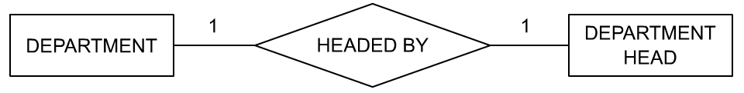
Object-Based Logical Model (Contd.)
  The following diagram represents the one-to-one relationship between DEPARTMENT and DEPARTMENT HEAD.
  For a particular DEPARTMENT there can be only one DEPARTMENT HEAD.
Notes:
Student already have learnt about type 2 SCDs in Module I. Therefore, you can start this topic by asking the following questions to students:
What are type 2 SCDs?
Given an example to explain type 2 SCDs.
This will recapitulate what they have learnt about type 2 SCD in Module 1.
Now explain the strategy to update the data into these dimension tables with help the example given in SG.
After explaining the examples, you can ask students to think of an example of a type 2 SCD and then tell the strategy to update the data into this dimension table.

Slide 22
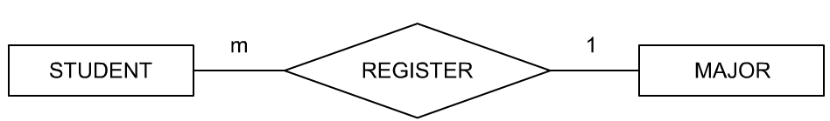
Object-Based Logical Model (Contd.)
The following diagram represents the many-to-one relationship between STUDENT and MAJOR.
A STUDENT can MAJOR in only one course, but many STUDENTs can register for a given MAJOR course.
Notes:
Student already have learnt about type 2 SCDs in Module I. Therefore, you can start this topic by asking the following questions to students:
What are type 2 SCDs?
Given an example to explain type 2 SCDs.
This will recapitulate what they have learnt about type 2 SCD in Module 1.
Now explain the strategy to update the data into these dimension tables with help the example given in SG.
After explaining the examples, you can ask students to think of an example of a type 2 SCD and then tell the strategy to update the data into this dimension table.

Slide 23
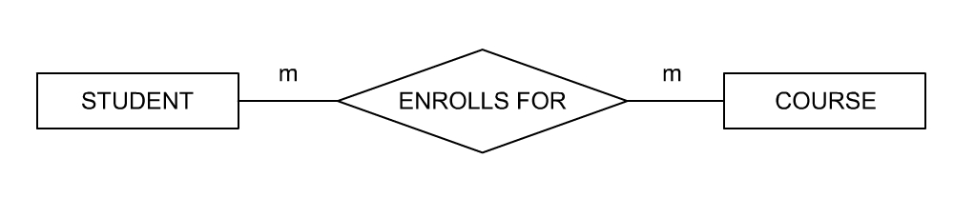
Object-Based Logical Model (Contd.)
The following diagram represents the many-to-many relationship between STUDENT and COURSE.
A STUDENT can take many COURSEs and many STUDENTs can register for a given COURSE.
Notes:
Student already have learnt about type 2 SCDs in Module I. Therefore, you can start this topic by asking the following questions to students:
What are type 2 SCDs?
Given an example to explain type 2 SCDs.
This will recapitulate what they have learnt about type 2 SCD in Module 1.
Now explain the strategy to update the data into these dimension tables with help the example given in SG.
After explaining the examples, you can ask students to think of an example of a type 2 SCD and then tell the strategy to update the data into this dimension table.

Slide 24
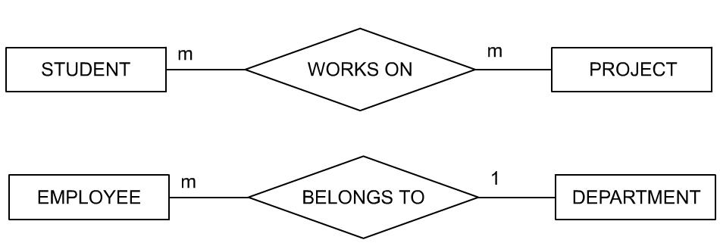
Just a minute
What do the following ER diagrams represent?
Solution:
  Many students can work on many projects.
  Many employees belong to only one department.
Notes:
Student already have learnt about type 2 SCDs in Module I. Therefore, you can start this topic by asking the following questions to students:
What are type 2 SCDs?
Given an example to explain type 2 SCDs.
This will recapitulate what they have learnt about type 2 SCD in Module 1.
Now explain the strategy to update the data into these dimension tables with help the example given in SG.
After explaining the examples, you can ask students to think of an example of a type 2 SCD and then tell the strategy to update the data into this dimension table.

Slide 25

Just a minute
Consider the following statement of a manufacturing company:
“A supplier supplies certain parts. A particular part is not necessarily supplied by only one supplier. No supplier supplies only a single part.”
What type of relationship is this? Draw a diagram to depict the relationship.
Solution:
  Many-to-many relationship
Notes:
Student already have learnt about type 2 SCDs in Module I. Therefore, you can start this topic by asking the following questions to students:
What are type 2 SCDs?
Given an example to explain type 2 SCDs.
This will recapitulate what they have learnt about type 2 SCD in Module 1.
Now explain the strategy to update the data into these dimension tables with help the example given in SG.
After explaining the examples, you can ask students to think of an example of a type 2 SCD and then tell the strategy to update the data into this dimension table.

Slide 26
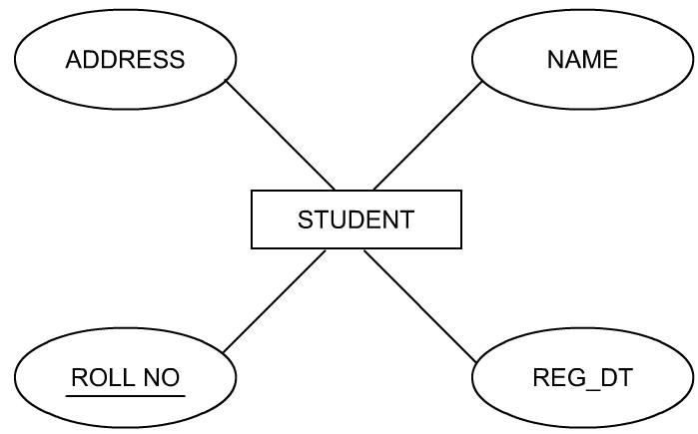
Object-Based Logical Model (Contd.)
An attribute:
  Is a property of a given entity.
  Is depicted as ellipses, labeled with the name of the property.
The following diagram shows the various attributes of the entity, STUDENT.
Notes:
Student already have learnt about type 2 SCDs in Module I. Therefore, you can start this topic by asking the following questions to students:
What are type 2 SCDs?
Given an example to explain type 2 SCDs.
This will recapitulate what they have learnt about type 2 SCD in Module 1.
Now explain the strategy to update the data into these dimension tables with help the example given in SG.
After explaining the examples, you can ask students to think of an example of a type 2 SCD and then tell the strategy to update the data into this dimension table.

Slide 27
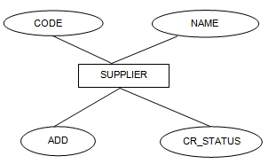
Just a minute
A manufacturer needs to maintain the following details about the supplier:
  Name
  Address
  Credit status
  Assigned code number
  Draw a diagram to depict this information.
Solution:
Notes:
Student already have learnt about type 2 SCDs in Module I. Therefore, you can start this topic by asking the following questions to students:
What are type 2 SCDs?
Given an example to explain type 2 SCDs.
This will recapitulate what they have learnt about type 2 SCD in Module 1.
Now explain the strategy to update the data into these dimension tables with help the example given in SG.
After explaining the examples, you can ask students to think of an example of a type 2 SCD and then tell the strategy to update the data into this dimension table.

Slide 28
Object-Based Logical Model (Contd.)
A subtype:
  Is a subset of another entity.
  Is always dependent on the supertype for its existence.
The attributes of a supertype apply to all of its subtypes.
Notes:
Student already have learnt about type 2 SCDs in Module I. Therefore, you can start this topic by asking the following questions to students:
What are type 2 SCDs?
Given an example to explain type 2 SCDs.
This will recapitulate what they have learnt about type 2 SCD in Module 1.
Now explain the strategy to update the data into these dimension tables with help the example given in SG.
After explaining the examples, you can ask students to think of an example of a type 2 SCD and then tell the strategy to update the data into this dimension table.

Slide 29
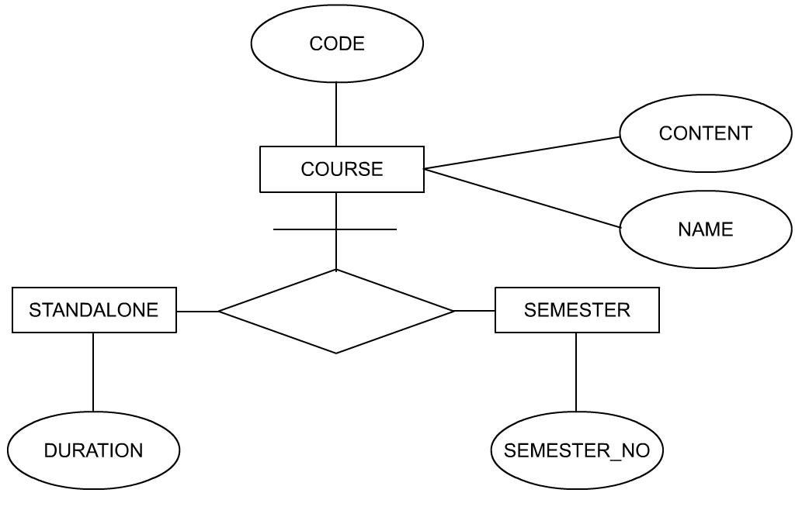
Object-Based Logical Model (Contd.)
The following diagram shows the relationship between supertype (COURSE) and subtypes (STANDLONE and SEMESTER).
The supertype is connected to the relationship with a line containing a crossbar.
Notes:
Student already have learnt about type 2 SCDs in Module I. Therefore, you can start this topic by asking the following questions to students:
What are type 2 SCDs?
Given an example to explain type 2 SCDs.
This will recapitulate what they have learnt about type 2 SCD in Module 1.
Now explain the strategy to update the data into these dimension tables with help the example given in SG.
After explaining the examples, you can ask students to think of an example of a type 2 SCD and then tell the strategy to update the data into this dimension table.

Slide 30
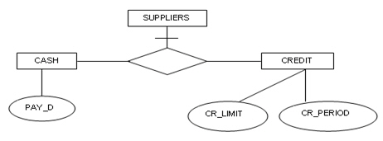
Just a minute
There are two types of suppliers. One type of supplier allows credit, while the other type insists on payment in cash before delivery. The manufacturer wishes to maintain separate information on these two types of suppliers. For the credit supplier, “credit period” and “credit limit” have to be recorded. For the cash supplier, “date of payment” has to be stored. Represent this information diagrammatically.
Solution:
Notes:
Student already have learnt about type 2 SCDs in Module I. Therefore, you can start this topic by asking the following questions to students:
What are type 2 SCDs?
Given an example to explain type 2 SCDs.
This will recapitulate what they have learnt about type 2 SCD in Module 1.
Now explain the strategy to update the data into these dimension tables with help the example given in SG.
After explaining the examples, you can ask students to think of an example of a type 2 SCD and then tell the strategy to update the data into this dimension table.

Slide 31
Summary
In this session, you learned that:
  Data models can be classified as:
    Object-based logical model
    Record-based logical model
  In the ER diagramming technique:
    Entities are represented as rectangles.
    Relationships are represented as diamonds.
    Attributes are represented as ellipses.
  Relationships, whether many-to-many, one-to-many, or one-to-one are represented symbolically.
  Weak entities are represented by double-lined boxes.
  Subtypes are connected to the supertype by an unnamed relationship, marked with a crossbar on top.
Notes:
You can summarize the session by running through the summary given in SG.
In addition, you can also ask students summarize what they have learnt in this session.

